Slide 1
ECO102: Introduction to Macroeconomics
Lecturer: Addrita Shams (RTA)
Lecture 08
Chapter 23: Economic Growth

Slide 2
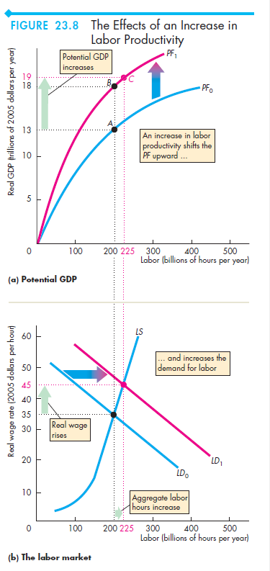
Growth of Labor Productivity
Labor productivity is the quantity of real GDP produced by an hour of labor. It is calculated by dividing real GDP by aggregate labor hours.
When labor productivity grows, real GDP per person grows and brings a rising standard of living.
Labor productivity increases, production possibilities expand. The quantity of real GDP that any given quantity of labor can produce increases.
If labor is more productive, firms are willing to pay more for a given number of hours of labor so the demand for labor also increases.
So an increase in labor productivity increases potential GDP for two reasons: Labor is more productive and more labor is employed.

Slide 3
Why Labour Productivity Grows?
Labor productivity growth is essential if real GDP per person and the standard of living are to grow.
Preconditions for Labor Productivity Growth
The fundamental precondition for labor productivity growth is the incentive system created by firms, markets, property rights, and money.
It was the presence of secure property rights in Britain in the middle 1700s that got the Industrial Revolution going.
With the preconditions for labor productivity growth in place, three things influence its pace:
■ Physical capital growth
■ Human capital growth
■ Technological advances

Slide 4
Physical Capital Growth
As the amount of capital per worker increases, labor productivity also increases.
Production processes that use hand tools can create beautiful objects, but production methods that use large amounts of capital per worker are much more productive.
Human Capital Growth
Human capital—the accumulated skill and knowledge of human beings—is the fundamental source of labor productivity growth.
Human capital grows when a new discovery is made and it grows as more and more people learn how to use past discoveries
Technological Advances
Technological change—the discovery and the application of new technologies— has made an even greater contribution
Technological advance arises from formal research and development programs and from informal trial and error, and it involves discovering new ways of getting more out of our resources.
To reap the benefits of technological change, capital must increase.

Slide 5
Growth Theories (Self-study)
Alternative theories of economic growth provide insights into the process of economic growth, but none provides a complete and definite answer to the basic questions: What causes economic growth and why do growth rates vary?
The three main theories of economic growth:
■ Classical growth theory
■ Neoclassical growth theory
■ New growth theory

Slide 6
Classical Growth Theory
Classical growth theory is the view that the growth of real GDP per person is temporary and that when it rises above the subsistence level, a population explosion eventually brings it back to the subsistence level.
Adam Smith, Thomas Robert Malthus, and David Ricardo—the leading economists of the late eighteenth century and early nineteenth century—proposed this theory.
The view is most closely associated with the name of Malthus and is sometimes called the Malthusian theory.
The theory suggests that population growth can outpace resources, and real GDP per person would decline, and we would return to a primitive standard of living.
Modern-day Malthusians also point to global warming and climate change as reasons to believe that eventually, real GDP per person will decrease.

Slide 7
Neoclassical Growth Theory
Neoclassical growth theory is the proposition that real GDP per person grows because technological change induces saving and investment that make capital per hour of labor grow.
Growth ends if technological change stops because of diminishing marginal returns to both labor and capital.
Robert Solow of MIT suggested the most popular version of this growth theory in the 1950s.
The neoclassical theory of population growth focuses in the relationship between population growth and economic development. As society undergoes industrialisation there is a shift from high birth and death rates to low birth and death rates.
In neoclassical growth theory, the pace of technological change influences the economic growth rate but economic growth does not influence the pace of technological change.

Slide 8
New Growth Theory
New growth theory holds that real GDP per person grows because of the choices people make in the pursuit of profit and that growth will persist indefinitely.
Paul Romer of Stanford University developed this theory during the 1980s, based on ideas of Joseph Schumpeter during the 1930s and 1940s.
According to the new growth theory, the pace at which new discoveries are made—and at which technology advances—is not determined by chance.
It depends on how many people are looking for a new technology and how intensively they are looking. The search for new technologies is driven by incentives.
Two facts about discoveries and technological knowledge play a key role in the new growth theory: Discoveries are (at least eventually) a public capital good; and knowledge is capital that is not subject to diminishing marginal returns.

